Slide 1
Module 7.2: Windows Architecture and Operations
Endpoint Security | Cisco Networking Academy
Prepared by: Kudzaishe Majeza

Slide 2
Hardware Abstraction Layer (HAL)
HAL is a layer between hardware and the operating system
Allows Windows to work with different hardware types
Provides a standard interface for drivers and the kernel
Improves compatibility and portability

Slide 3
User Mode vs Kernel Mode
Windows operates in two main modes
User Mode: where normal applications run
Limited access to system resources
Kernel Mode: core part of the OS runs here
Has full access to hardware and memory

Slide 4
Why the Two Modes Matter
Improves system stability and security
User applications cannot directly affect hardware
Prevents faulty apps from crashing the whole system
Kernel handles critical tasks like memory and drivers

Slide 5
Windows File Systems
File system manages how data is stored and retrieved
Common Windows file systems: FAT32, NTFS, exFAT
NTFS is the most widely used in modern Windows
Supports permissions, encryption, and large files

Slide 6
NTFS Features
File and folder permissions
Disk quotas
File compression
Encryption using EFS
Journaling for data recovery

Slide 7
Alternate Data Streams (ADS)
Feature of NTFS file system
Allows multiple data streams in a single file
Can store hidden information inside files
Sometimes used by attackers to hide malware

Slide 8
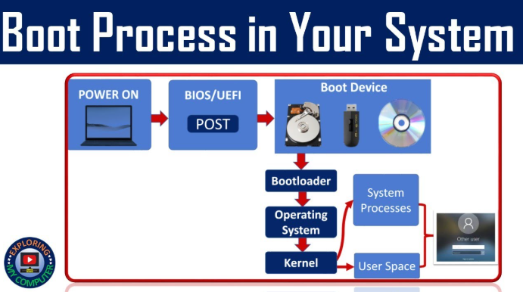
Windows Boot Process
Process that starts the computer and loads Windows
Begins when the system is powered on
BIOS/UEFI performs hardware checks
Bootloader loads the Windows kernel
Kernel initializes system components

Slide 9
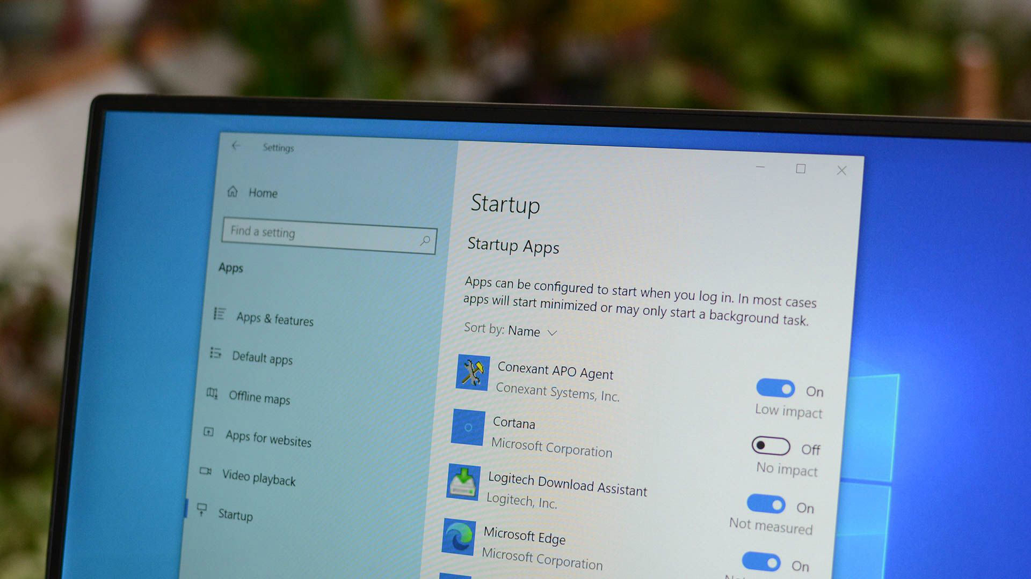
Windows Startup
Occurs after the kernel is loaded
System services and drivers are started
User login screen appears
Startup programs are launched after login

Slide 10

Windows Shutdown
Closes all running applications
Stops system services
Saves settings and system state
Safely powers off the hardware

Slide 11
Processes, Threads, and Services
Process: a running instance of a program
Thread: a smaller unit of execution inside a process
Services: background processes that run without user interaction
Managed by Task Manager and Service Manager

Slide 12
Memory Allocation and Handles
Windows manages memory for each process
Prevents programs from interfering with each other
Handles are references to system resources
Used for files, devices, and memory objects

Slide 13
The Windows Registry
Central database for system and application settings
Stores configuration information
Organized into keys and values
Critical for system operation

Slide 14
Registry Hives
Major sections of the Windows Registry
Examples: HKEY_LOCAL_MACHINE, HKEY_CURRENT_USER
Contain hardware, software, and user settings
Changes should be made carefully

